Slide 1
Bayesian Inference
Module 3, Lesson 2

Slide 2
Conjugate Priors
Shahrzad Jamshidi, PhD

Slide 3
Last Time
Nuisance parameters
Simulations of normal models where both mean and variance are unknown

Slide 4
Objectives
Analyze normal data using conjugate and semi-conjugate prior distributions.
Understand and apply the multivariate normal model with known variance.
Analyze multivariate normal data with unknown mean and variance.

Slide 5

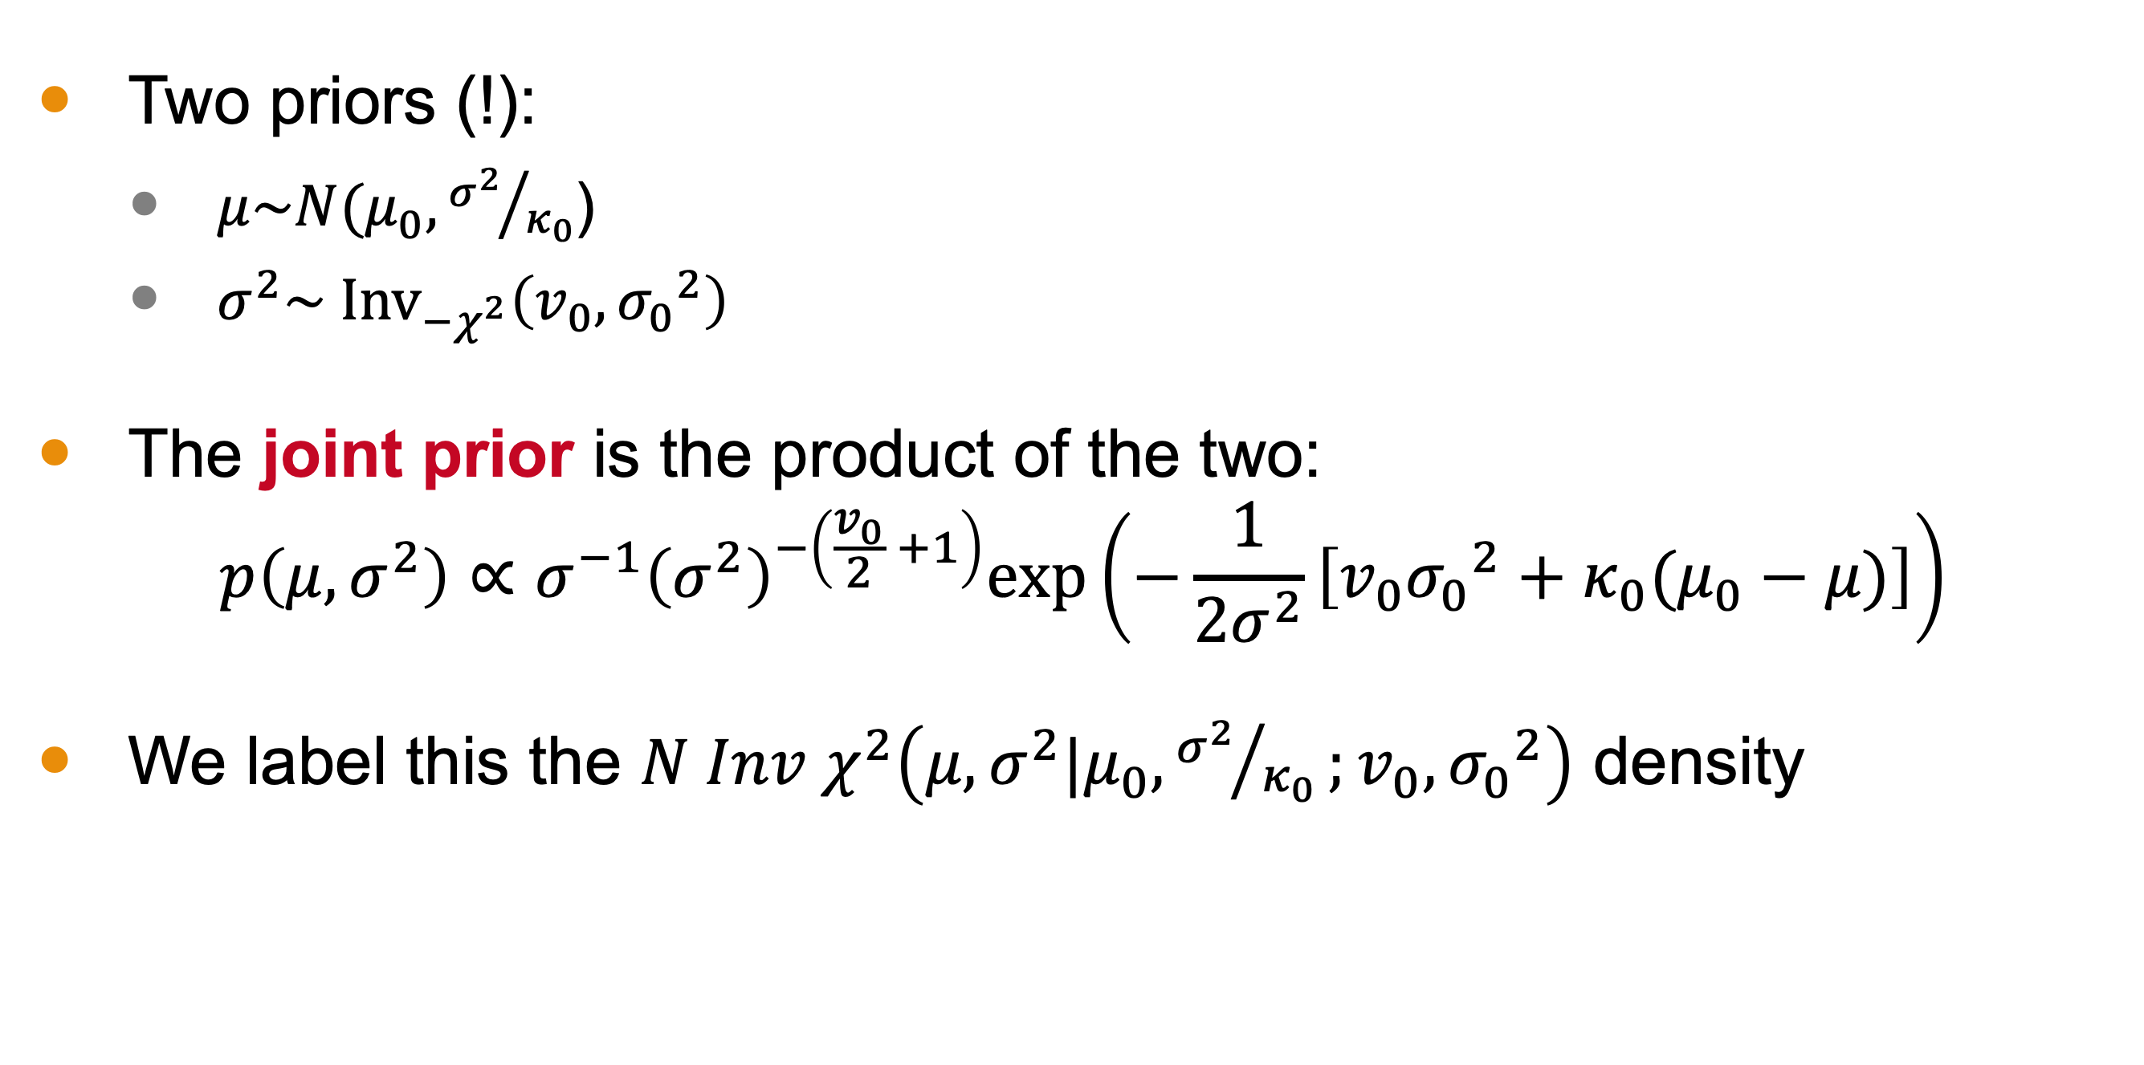

Conjugate Prior Distribution
Two priors (!):
$μ\sim N(μ_{0},{σ^{2}}/{κ_{0}}$)
$σ^{2}\sim {\text{Inv}}_{−χ^{2}}\left(v_{0}, {σ_{0}}^{2}\right)$
The joint prior is the product of the two:
$$p\left(μ,σ^{2}\right)∝σ^{−1}{\left(σ^{2}\right)}^{−\left(\frac{v_{0}}{2} +1\right)}\text{exp}\left(−\frac{1}{2σ^{2}}\left[v_{0}{σ_{0}}^{2}+κ_{0}(μ_{0}−μ)\right]\right)$$
We label this the $N Inv χ^{2}\left(μ,σ^{2}|μ_{0},{σ^{2}}/{κ_{0}};v_{0}, {σ_{0}}^{2}\right)$ density
Scale for $μ$
Scale for $σ^{2}$
Location
D o F

Slide 6
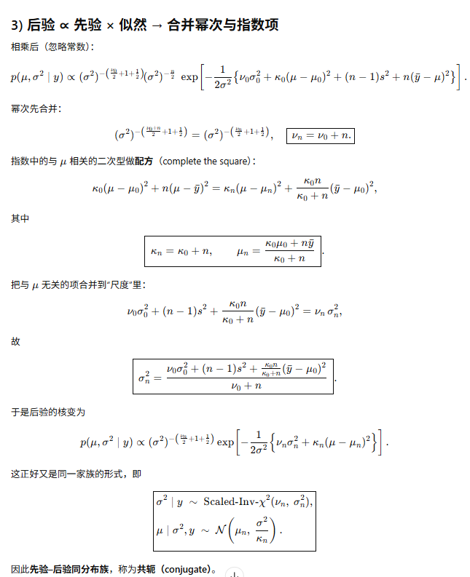
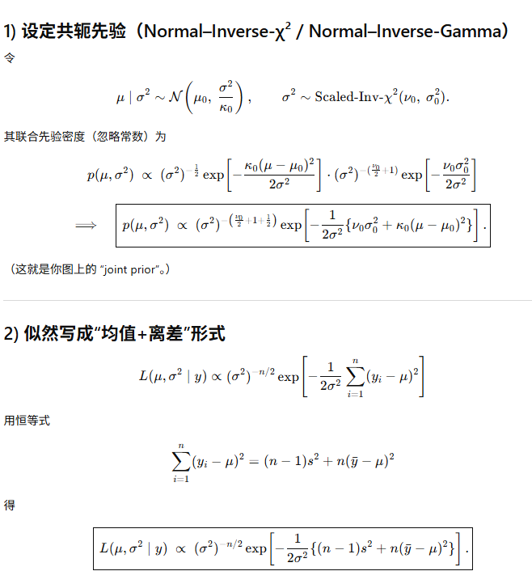
Derive the Conjugate Posterior
Notes:
Solving for the posterior distribution

Slide 7
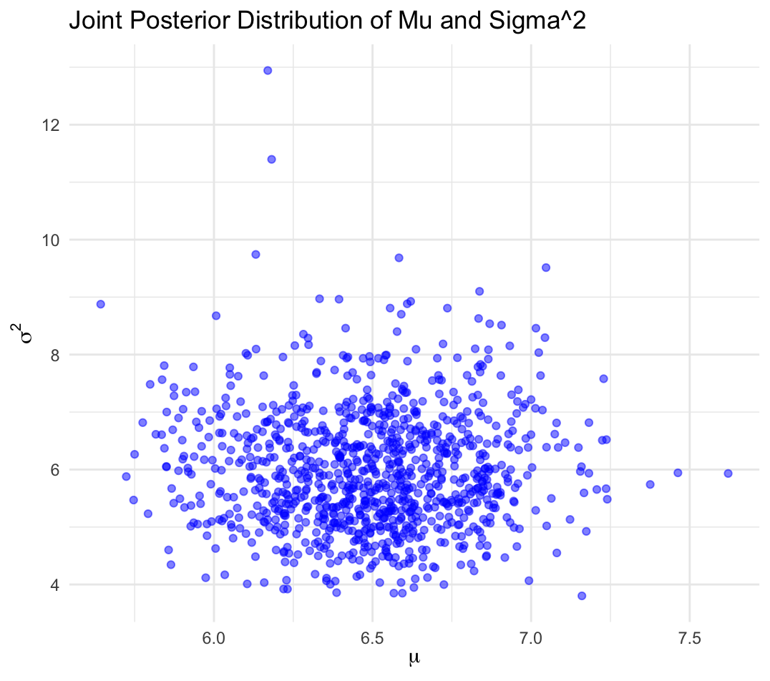
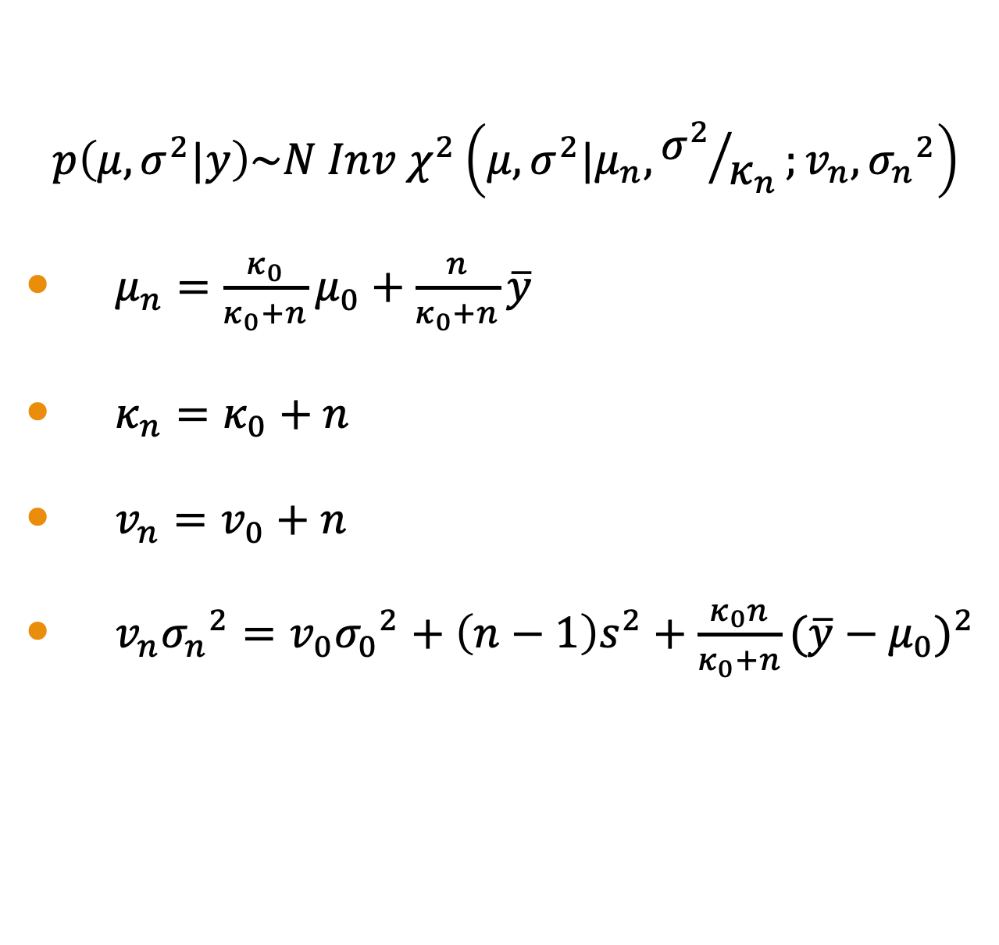
Conjugate Posterior
$$p\left(μ,σ^{2}|y\right)\sim N Inv χ^{2}\left(μ,σ^{2}|μ_{n},{σ^{2}}/{κ_{n}};v_{n}, {σ_{n}}^{2}\right)$$
$μ_{n}=\frac{κ_{0}}{κ_{0}+n}μ_{0}+\frac{n}{κ_{0}+n}\overline{y}$
$κ_{n}=κ_{0}+n$
$v_{n}=v_{0}+n$
$v_{n}{σ_{n}}^{2}=v_{0}{σ_{0}}^{2}+\left(n−1\right)s^{2}+\frac{κ_{0}n}{κ_{0}+n}{(\overline{y}−μ_{0})}^{2}$

Slide 8
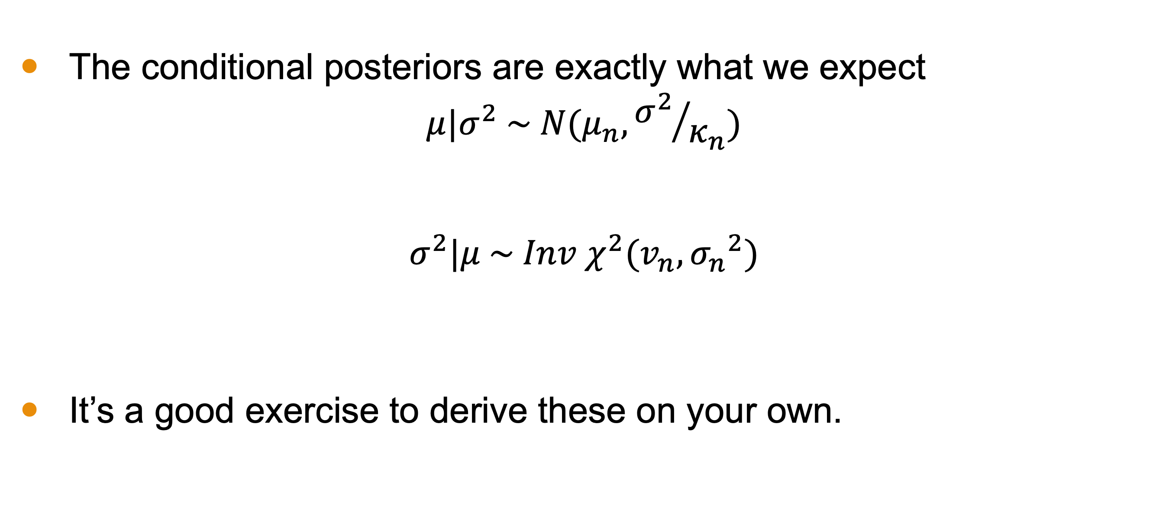
Exercise: Conditional Posteriors
The conditional posteriors are exactly what we expect
$$μ|σ^{2} \sim N(μ_{n},{σ^{2}}/{κ_{n}})$$
$$σ^{2}|μ \sim Inv χ^{2}(v_{n}, {σ_{n}}^{2})$$
It’s a good exercise to derive these on your own.

Slide 9
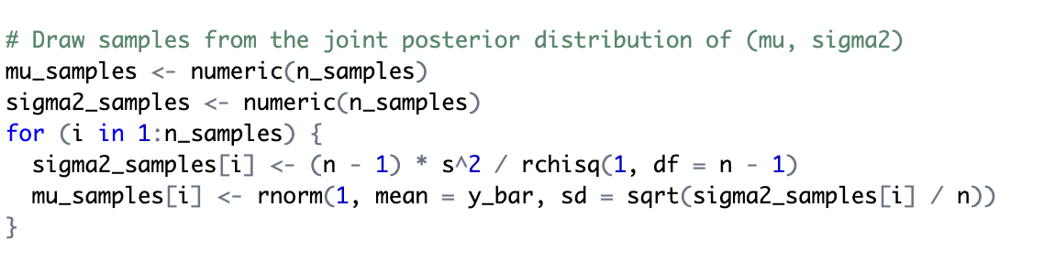
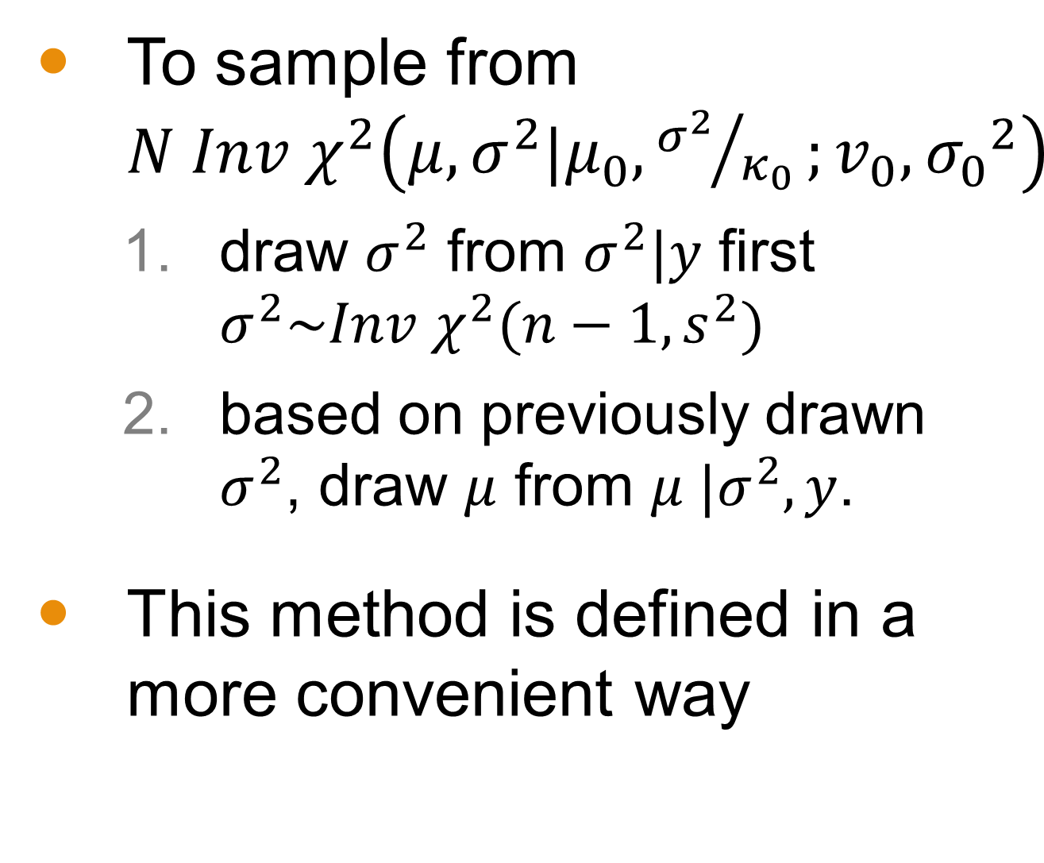
Sampling
To sample from $N Inv χ^{2}\left(μ,σ^{2}|μ_{0},{σ^{2}}/{κ_{0}};v_{0}, {σ_{0}}^{2}\right)$
draw $σ^{2}$ from $σ^{2}|y$ first $σ^{2}\sim Inv χ^{2}(n−1,s^{2})$
based on previously drawn $σ^{2}$, draw $μ$ from $μ |σ^{2},y$.
This method is defined in a more convenient way

Slide 10
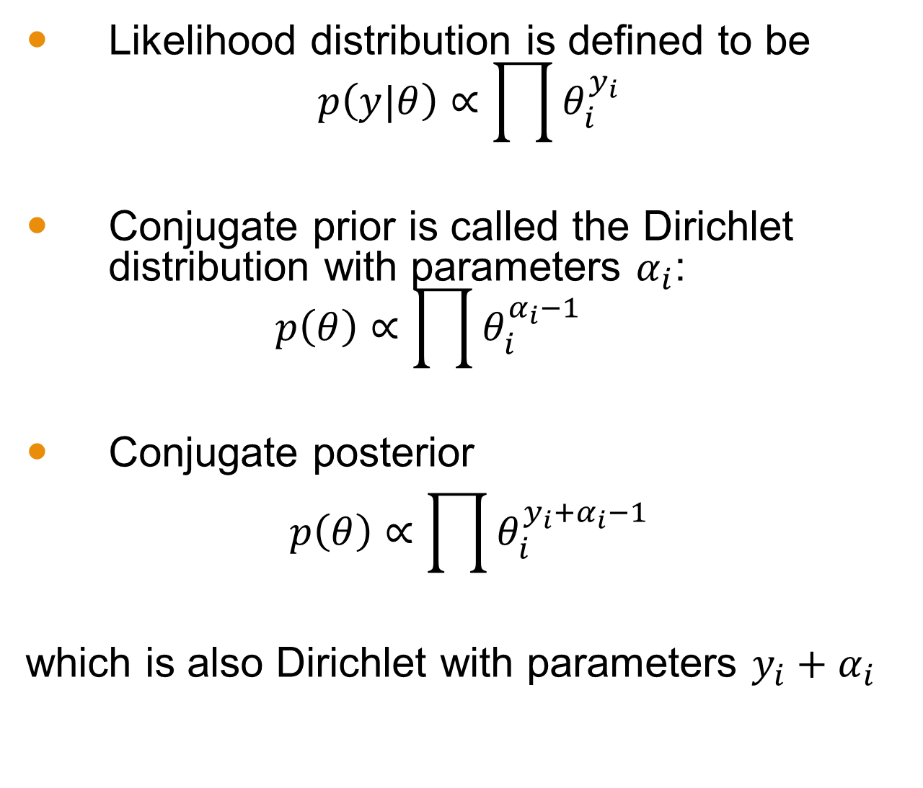
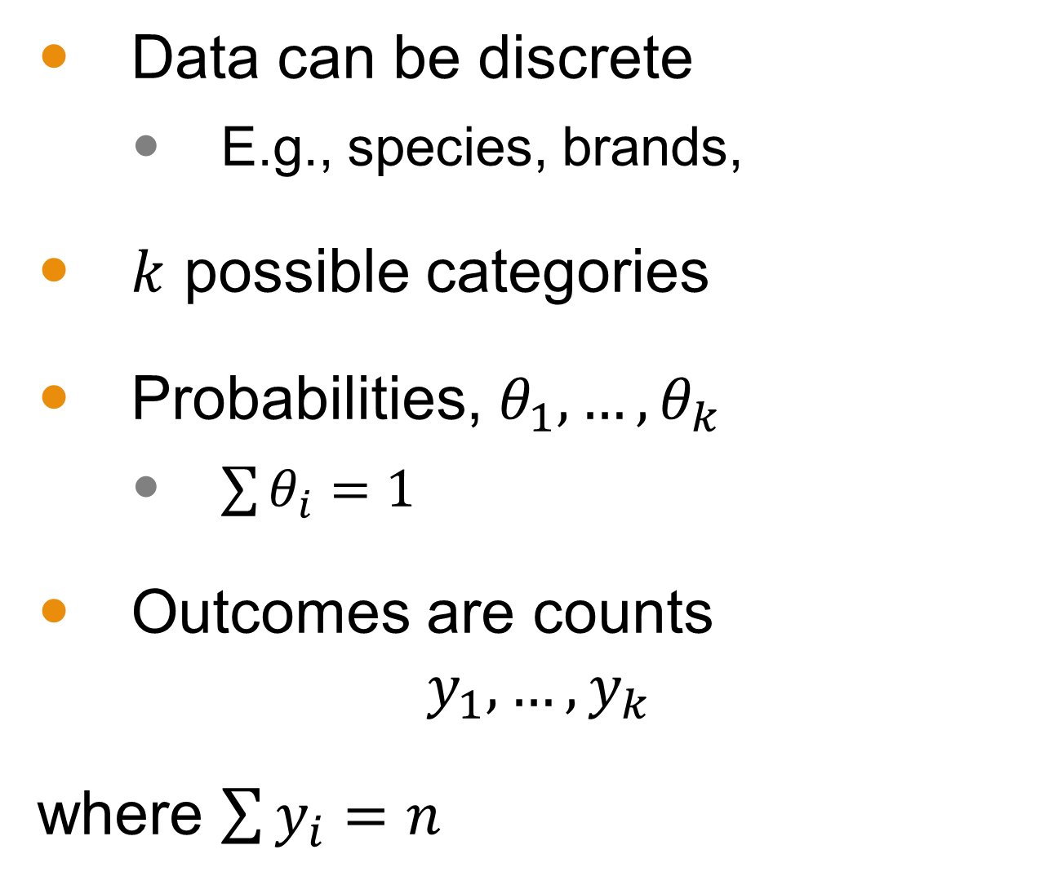
Multinomial Model for Categorical Data
Data can be discrete
E.g., species, brands,
$k$ possible categories
Probabilities, $θ_{1},…,θ_{k}$
$\sum{θ_{i}}=1$
Outcomes are counts
$$y_{1},…,y_{k}$$
where $\sum{y_{i}}=n$
Likelihood distribution is defined to be $p\left(y|θ\right)∝\prod{θ_{i}^{y_{i}}}$
Conjugate prior is called the Dirichlet distribution with parameters $α_{i}$: $p\left(θ\right)∝\prod{θ_{i}^{α_{i}−1}}$
Conjugate posterior
$$p\left(θ\right)∝\prod{θ_{i}^{{y_{i}+α}_{i}−1}}$$
which is also Dirichlet with parameters ${y_{i}+α}_{i}$

Slide 11
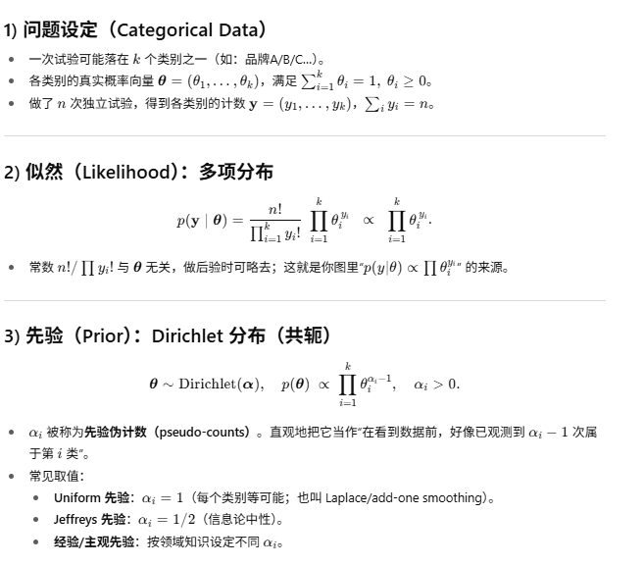
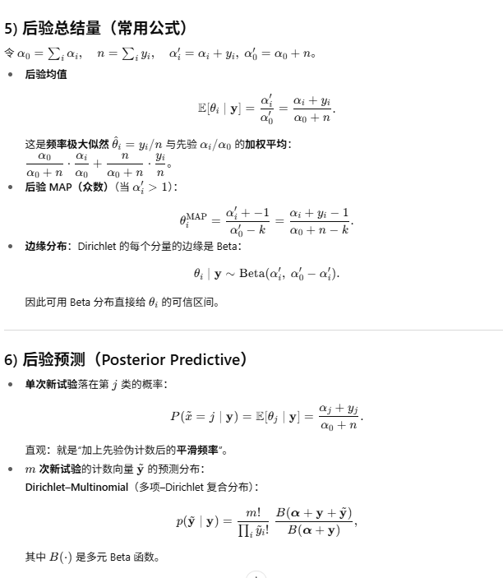
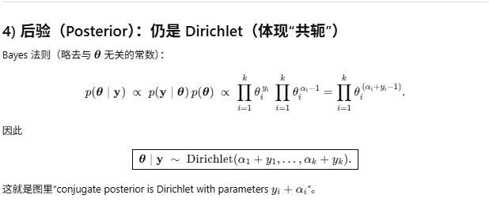
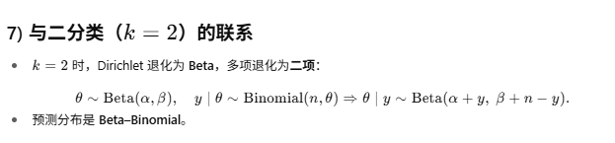
Multinomial Model for Categorical Data

Slide 12

Example: Ice Cream
Suppose a survey was conducted to determine the favorite ice cream flavor among three options: Vanilla, Chocolate, and Strawberry. Out of 1000 respondents:
450 preferred Vanilla
300 preferred Chocolate
250 preferred Strawberry
We want to estimate the difference in proportions between those who prefer Vanilla and those who prefer Chocolate.
Microsoft Stock Images

Slide 13
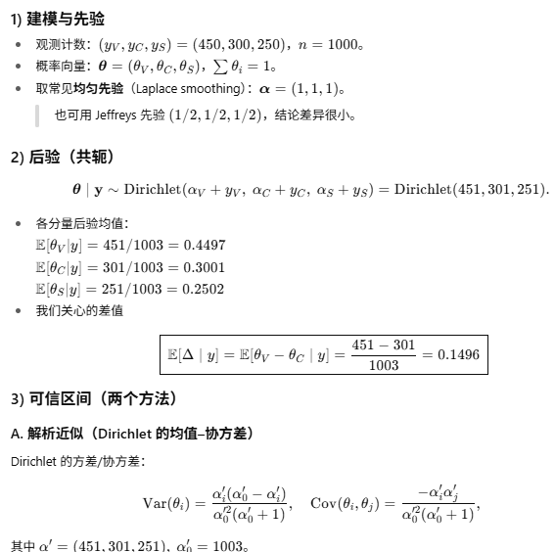
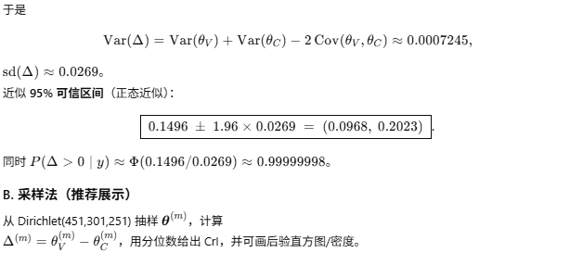
Notes:
Computation

Slide 14
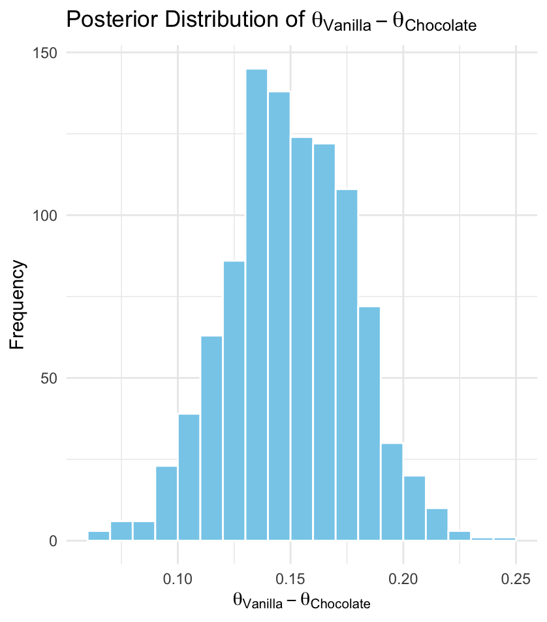
Example Distribution
Estimated probability that Vanilla has more support than Chocolate: >99%

Slide 15
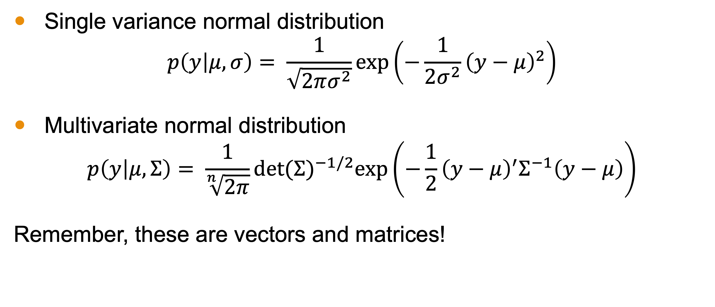
Multivariate Normal Distribution
Single variance normal distribution
$$p\left(y | μ,σ\right)= \frac{1}{\sqrt{2πσ^{2}}}exp\left(−\frac{1}{2σ^{2}}{\left(y−μ\right)}^{2}\right)$$
Multivariate normal distribution
$$p\left(y | μ,Σ\right)= \frac{1}{\sqrt[n]{2π}}{det⁡(Σ)}^{−1/2}exp\left(−\frac{1}{2}{\left(y−μ\right)}^{′}Σ^{−1}\left(y−μ\right)\right)$$
Remember, these are vectors and matrices!

Slide 16
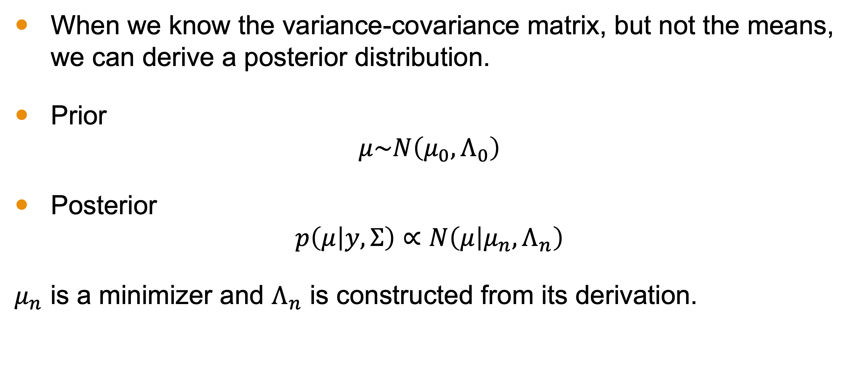

Case 1: Unknown $μ$ and Known $Σ$
When we know the variance-covariance matrix, but not the means, we can derive a posterior distribution.
Prior
$$μ\sim N\left(μ_{0},Λ_{0}\right)$$
Posterior
$$p\left(μ | y,Σ\right)∝N\left(μ | μ_{n},Λ_{n}\right)$$
$μ_{n}$ is a minimizer and $Λ_{n}$ is constructed from its derivation.

Slide 17
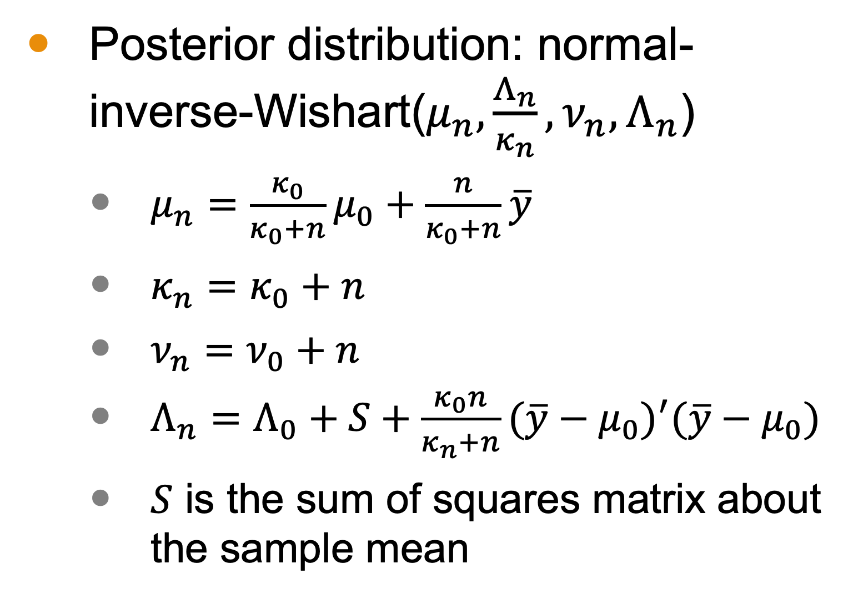
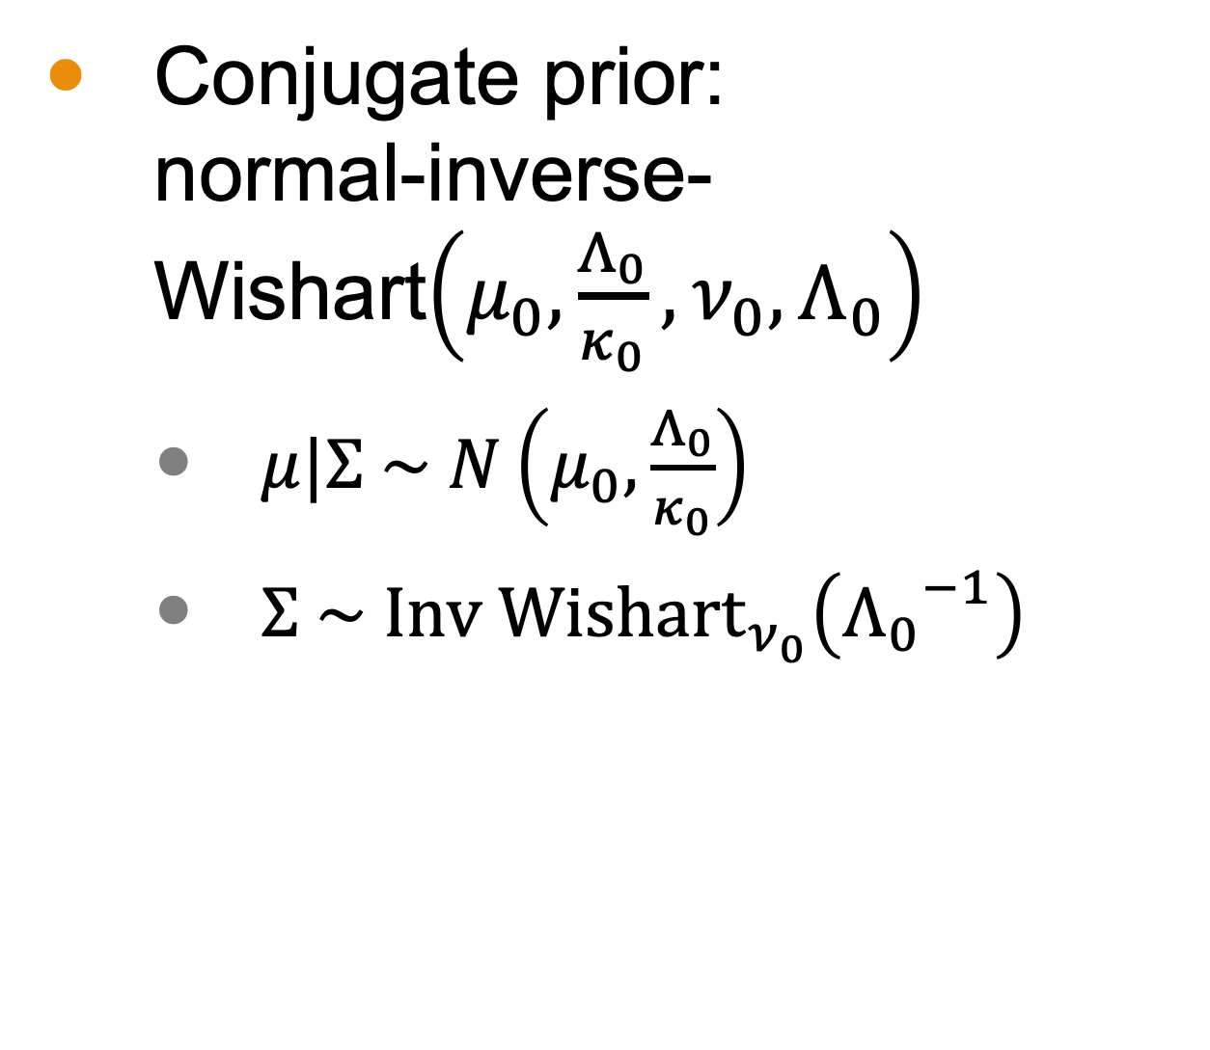

Case 2: Unknown $μ$ and Unknown $Σ$
Conjugate prior: normal-inverse-Wishart$\left(μ_{0},\frac{Λ_{0}}{κ_{0}},ν_{0},Λ_{0}\right)$
$μ|Σ \sim N\left(μ_{0},\frac{Λ_{0}}{κ_{0}}\right)$
$Σ \sim {\text{Inv} \text{Wishart}}_{ν_{0}}\left({Λ_{0}}^{−1}\right)$
Posterior distribution: normal-inverse-Wishart($μ_{n},\frac{Λ_{n}}{κ_{n}},ν_{n},Λ_{n}$)
$μ_{n}=\frac{κ_{0}}{κ_{0}+n}μ_{0}+\frac{n}{κ_{0}+n}\overline{y}$
$κ_{n}=κ_{0}+n$
$ν_{n}=ν_{0}+n$
$Λ_{n}=Λ_{0}+S+\frac{κ_{0}n}{κ_{n}+n}{(\overline{y}−μ_{0})}^{′}(\overline{y}−μ_{0})$
$S$ is the sum of squares matrix about the sample mean

Slide 18
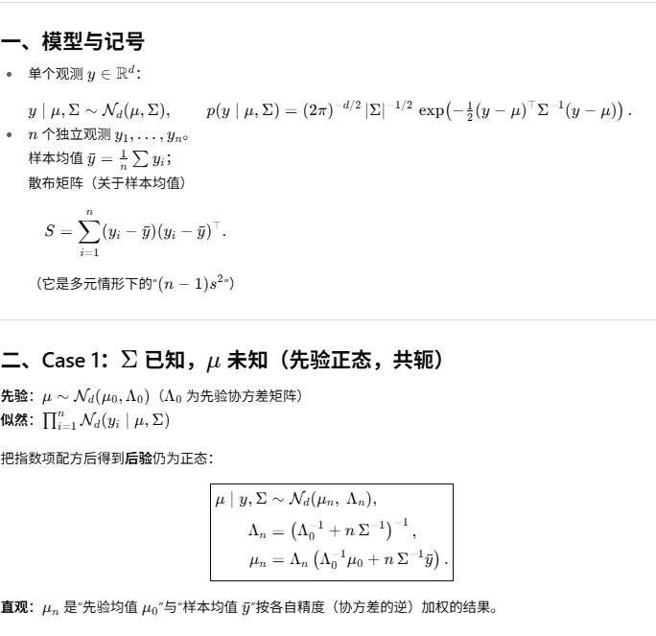
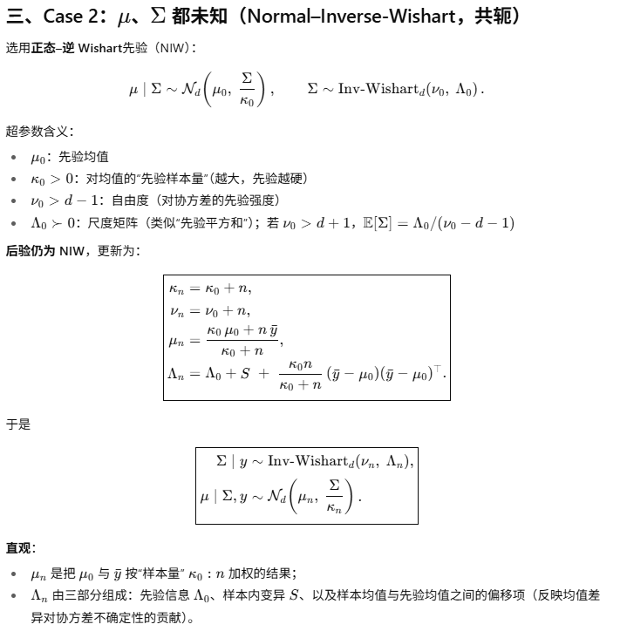
Notes:
Fish example

